Slide 1
Kalboard 360 Learning Management System Analysis w/ xAPI
BY: ERIC YE
INSTRUCTOR: MR.TAREQ JABER
SEPT 25th, 2020
Notes:
This is an educational dataset collected from a learning management system called Kalboard 360. Kalboard 360 is a multi-agent LMS, which has been designed to facilitate learning through the use of leading-edge technology. This technology was used to teach a sample of students from the University of Jordan over the span of two semesters, and their test results were recorded, as well as many other variables. In this analysis I try to associate and explain different variables to the different grading levels, which are low(0-69), medium(70-89), and high(90-100).

Slide 2
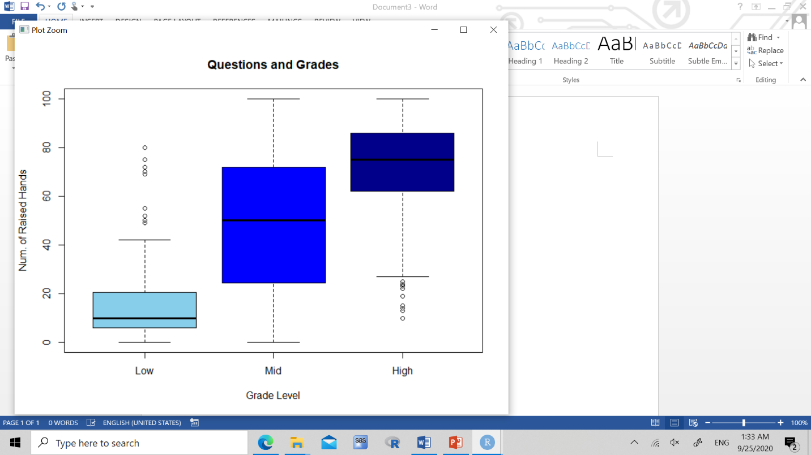
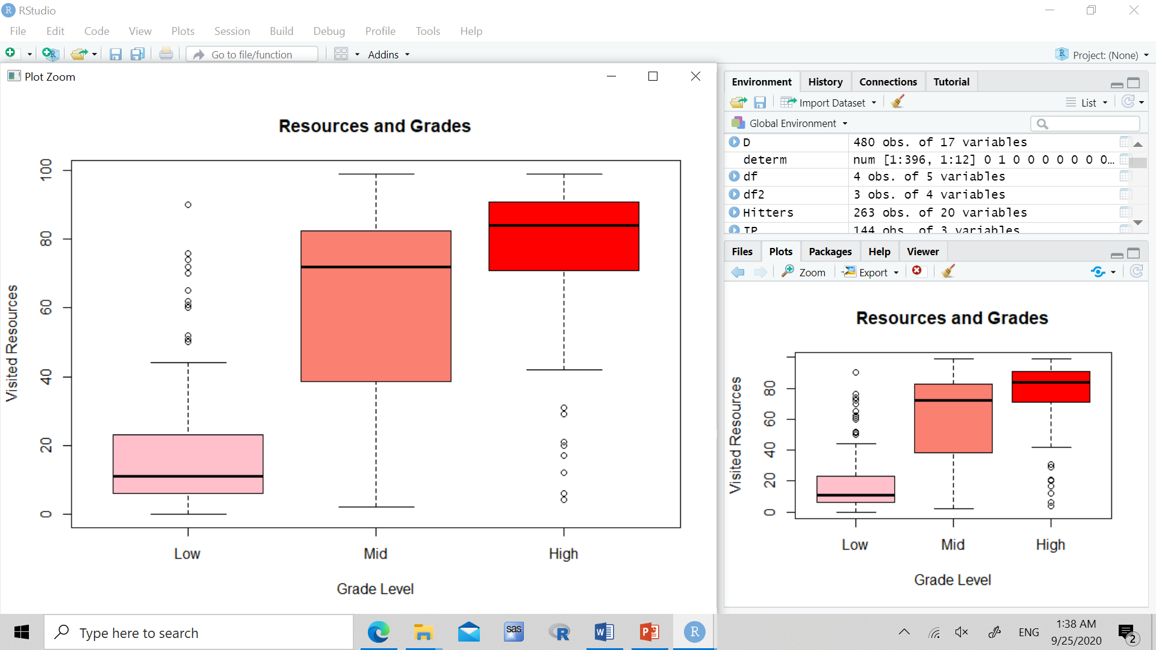

Slide 3
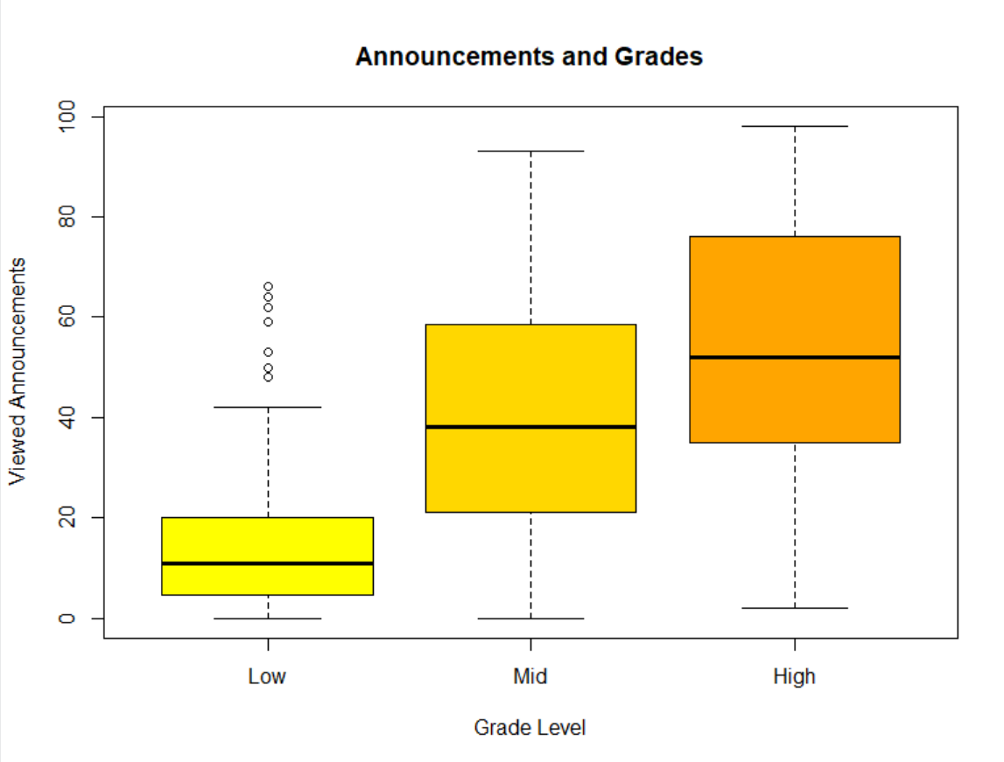
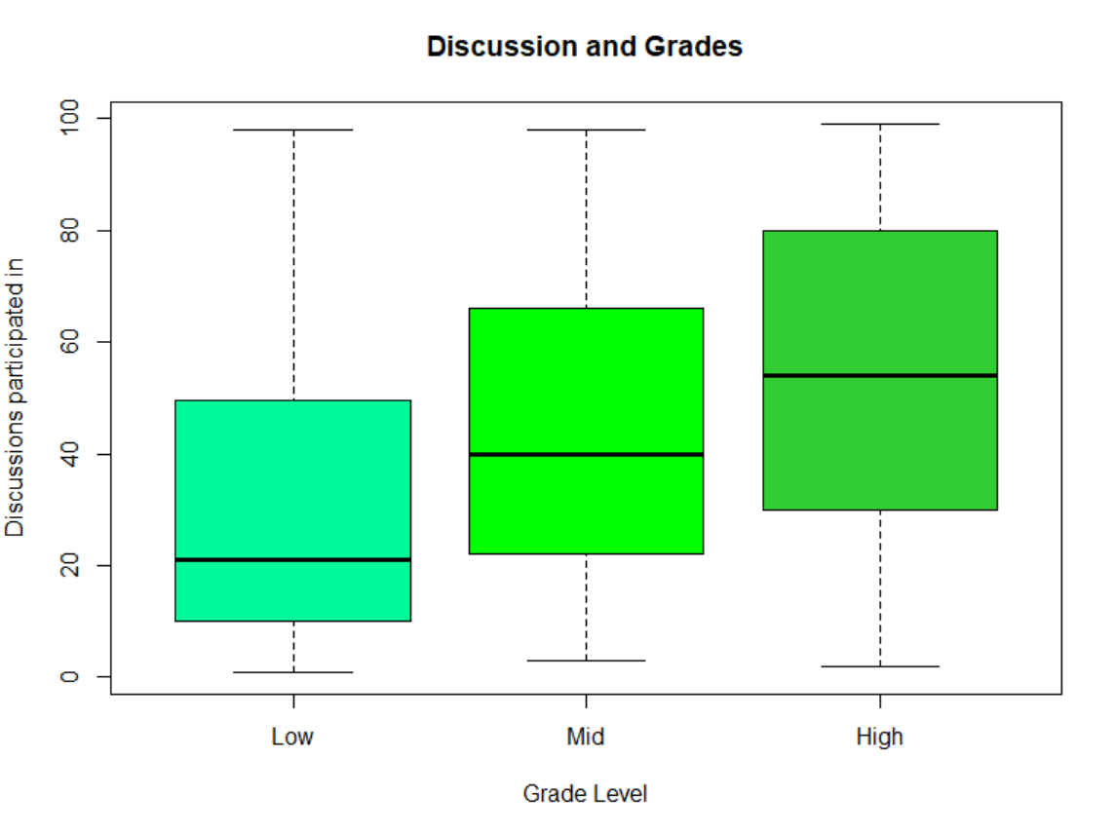

Slide 5
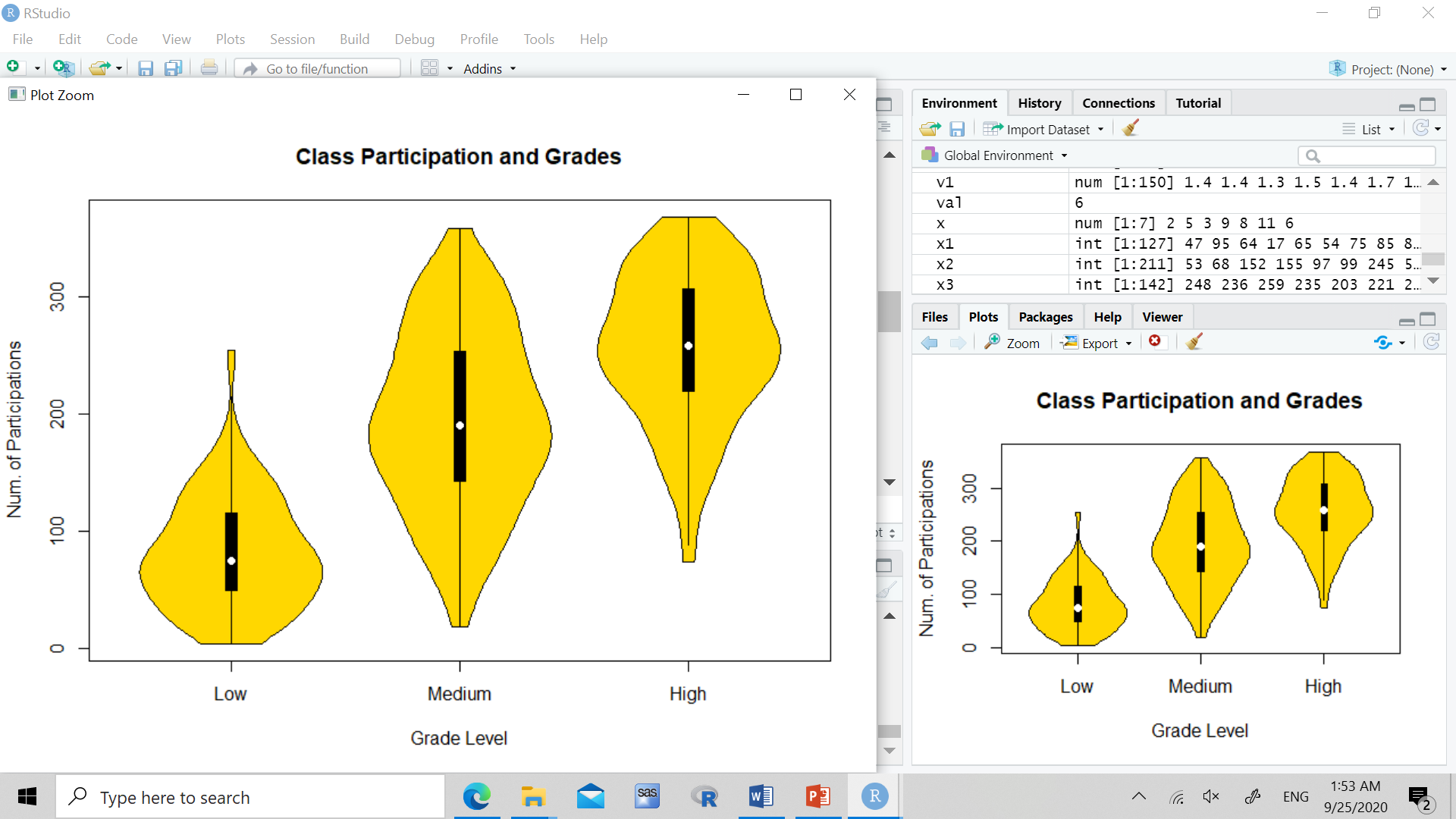

Slide 6
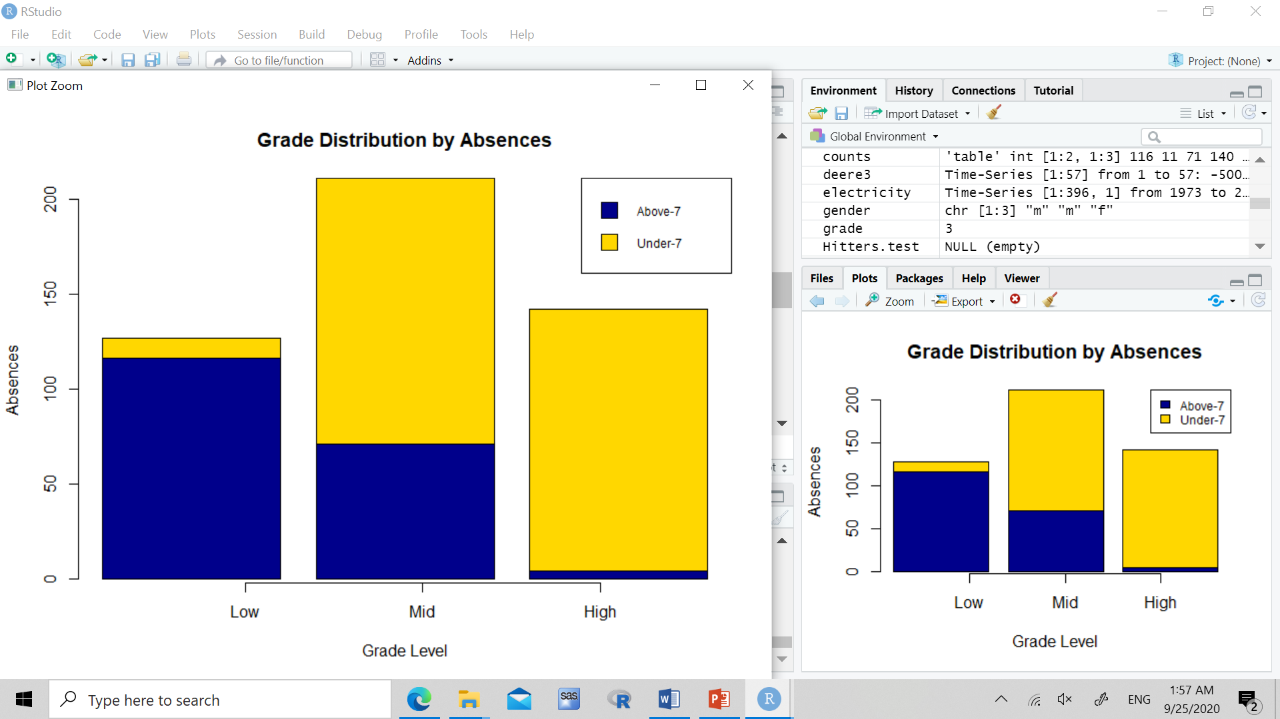

Slide 7
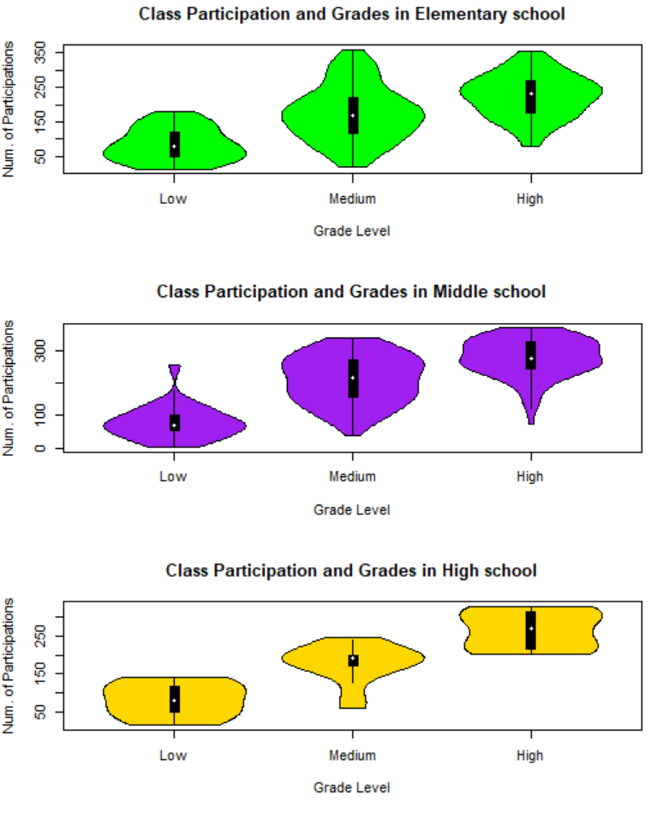

Slide 8
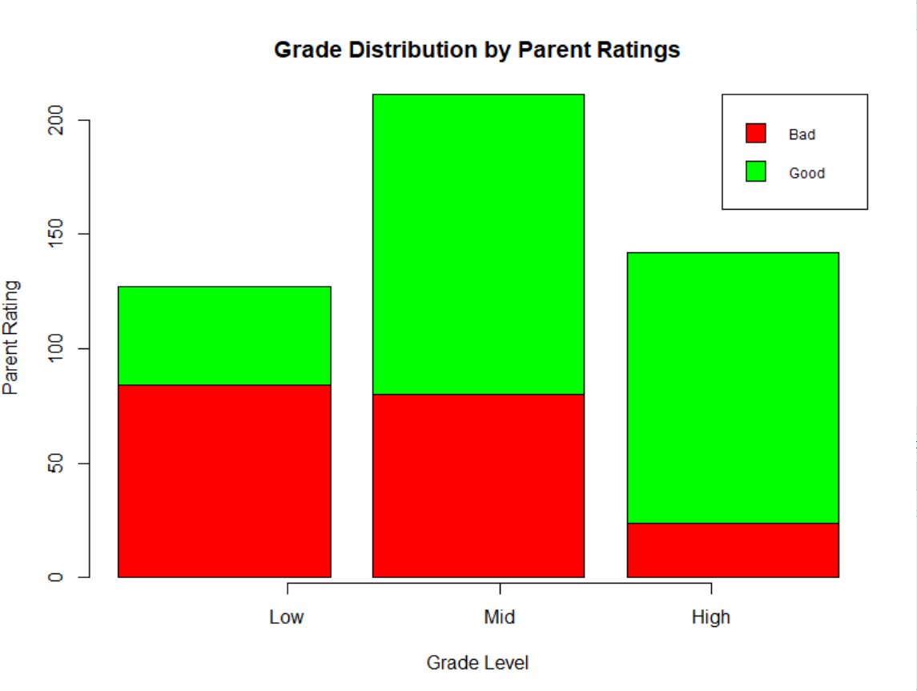

Slide 9
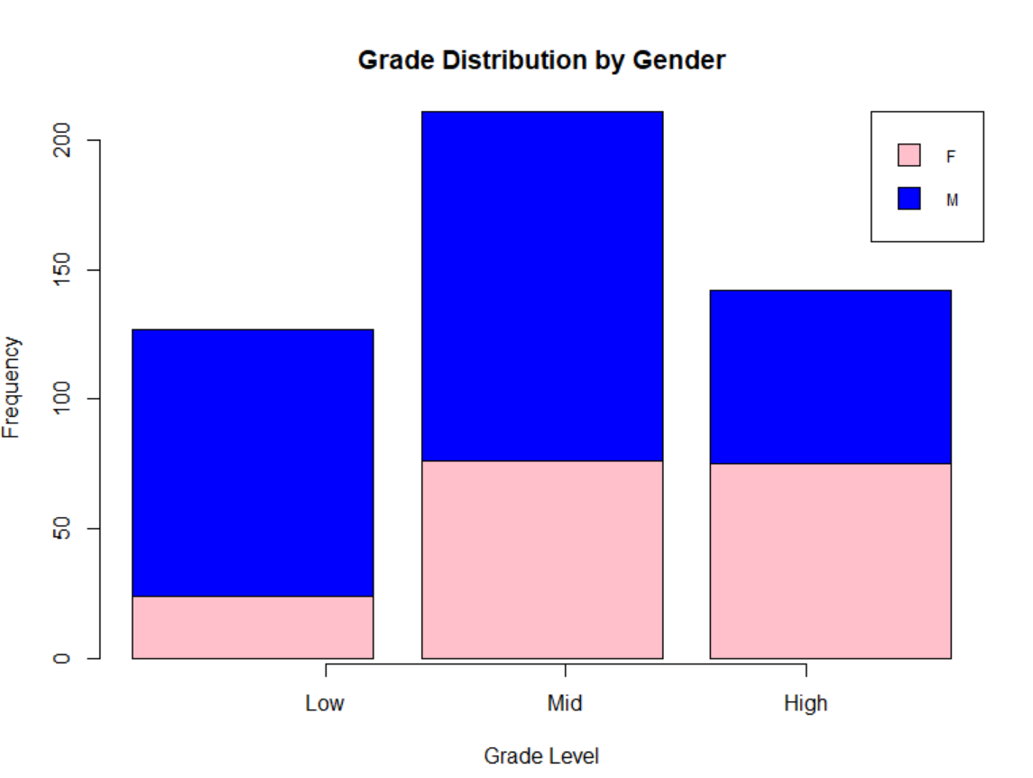

Slide 10
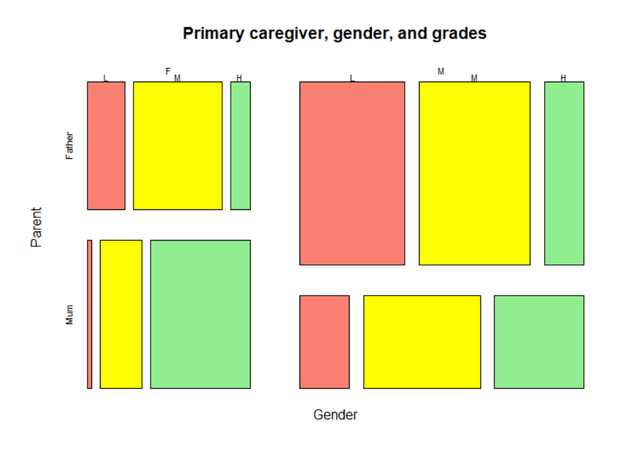

Slide 11
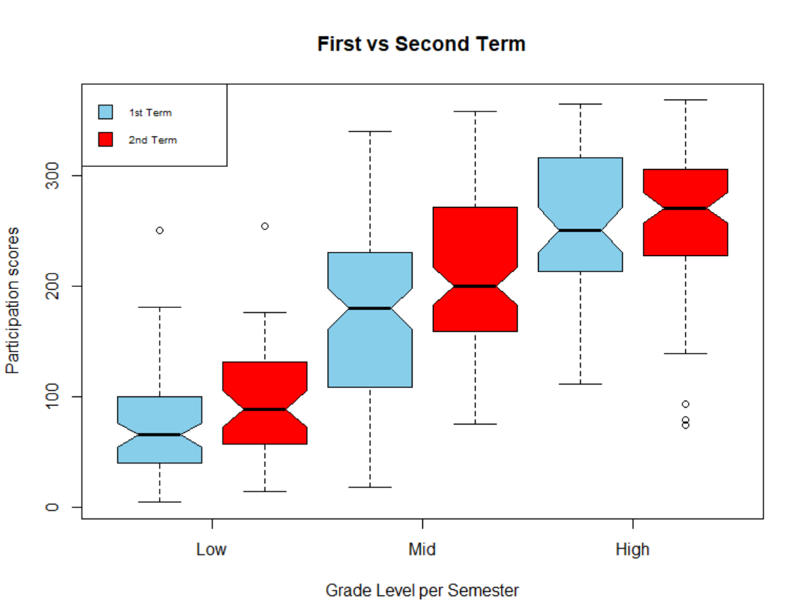

Slide 12
CONCLUSION
Most important factors in e learning (universal learning):
Participation
Attendance
Resources
Questions
Announcements
Discussions
Resources

Slide 13
Thanks for listening!
Questions?

